Slide 1
Introduction to Python

Slide 2
BRANCHING, ITERATION

Slide 3
STRINGS
letters, special characters, spaces, digits
enclose in quotation marks or single quotes
hi = "hello there"
concatenate strings
name = "ana"
greet = hi + name
greeting = hi + " " + name
do some operations on a string as defined in Python docs
silly = hi + " " + name * 3

Slide 4
INPUT/OUTPUT: print
used to output stuff to console
keyword is print
x = 1 print(x) x_str = str(x)
print("my fav num is", | x, ".", | "x =", x)
print("my fav num is " | + x_str | + ". " + "x = " + x_str)

Slide 5
INPUT/OUTPUT: input("")
prints whatever is in the quotes
user types in something and hits enter
binds that value to a variable
text = input("Type anything... ") print(5*text)
input gives you a string so must cast if working with numbers
num = int(input("Type a number... ")) print(5*num)

Slide 6
COMPARISON OPERATORS ON
int, float, string
i and j are variable names
comparisons below evaluate to a Boolean
i > j i >= j i < j
i <= j
i == j → equality test, True if i is the same as j
i != j → inequality test, True if i not the same as j

Slide 7
LOGIC OPERATORS ON bools
a and b are variable names (with Boolean values)
not a →
a and b →
a or b →
True if a is False False if a is True
True if both are True
True if either or both are True
 | A | B | A and B | A or B
 | True | True | True | True
 | True | False | False | True
 | False | True | False | True
 | False | False | False | False

Slide 8
COMPARISON EXAMPLE
pset_time = 15
sleep_time = 8 print(sleep_time derive = True drink = False
> pset_time)
both = drink and derive print(both)

Slide 9
CONTROL FLOW - BRANCHING
if <condition>:
<expression>
<expression>
...
if <condition>:
<expression>
<expression>
...
elif <condition>:
<expression>
<expression>
...
else:
<expression>
<expression>
...
if <condition>:
<expression>
<expression>
...
else:
<expression>
<expression>
...
<condition> has a value True or False
evaluate expressions in that block if <condition> is True

Slide 10
INDENTATION
matters in Python
how you denote blocks of code
x = float(input("Enter a number for x: ")) y = float(input("Enter a number for y: ")) if x == y:
print("x and y are equal"
if y != 0
print("x
and y are
equal"
)
if y != 0
:
print("therefore, x / y is", x/y
print("therefore
, x / y is",
x/y
)
elif x < y:
print("x s smaller"
print("x
is
smaller"
)
else:
print("y s smaller"
print("y
is
smaller"
)
print("thanks!")

Slide 11
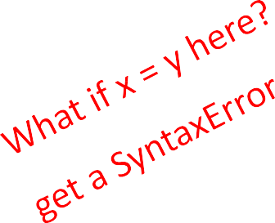
= vs ==
x = float(input("Enter y = float(input("Enter | a number a number | for x: ")) for y: "))
if x == y:
print("x and y are if y != 0: | equal")
print("therefore, x / y is", x/y) elif x < y:
print("x is smaller") else:
print("y is smaller") print("thanks!")

Slide 12
CONTROL FLOW:
while LOOPS
while <condition>:
<expression>
<expression>
...
<condition> evaluates to a Boolean
if <condition> is True, do all the steps inside the while code block
check <condition> again
repeat until <condition> is False

Slide 13
while LOOP EXAMPLE
You are in the Lost Forest.
************
************
☺
************
************
Go left or right?
PROGRAM:
n = input("You're in the Lost Forest. Go left or right? ")
while n == "right":
n = input("You're in the Lost Forest. Go left or right? ") print("You got out of the Lost Forest!")

Slide 14
CONTROL FLOW:
while and for LOOPS
iterate through numbers in a sequence
# more complicated with while loop n = 0
while n < 5:
print(n) n = n+1
# shortcut with for loop for n in range(5):
print(n)

Slide 15
CONTROL FLOW: for LOOPS
for <variable> in range(<some_num>):
<expression>
<expression>
...
each time through the loop, <variable> takes a value
first time, <variable> starts at the smallest value
next time, <variable> gets the prev value + 1
etc.

Slide 16
range(start,stop,step)
default values are start = 0 and step = 1 and optional
loop until value is stop - 1
mysum = 0
for i in range(7, 10): mysum += i
print(mysum)
mysum = 0
for i in range(5, 11, 2): mysum += i
print(mysum)

Slide 17
break STATEMENT
immediately exits whatever loop it is in
skips remaining expressions in code block
exits only innermost loop!
while <condition_1>: while <condition_2>:
<expression_a> break
<expression_b>
<expression_c>

Slide 18
break STATEMENT
mysum = 0
for i in range(5, 11, 2):
mysum
f mysum == 5
mysum
+=
i
if
mysum
== 5
:
break
break
mysum += 1 print(mysum)
what happens in this program?

Slide 19
for
VS while LOOPS
for loops
know number of iterations
can end early via
break
uses a counter
while loops
unbounded number of iterations
can end early via break
can use a counter but must initialize before loop and increment it inside loop
may not be able to rewrite a while loop using a for loop
can rewrite a for
loop
using a while loop

Slide 20
STRINGS
think of as a sequence of case sensitive characters
can compare strings with ==, >, < etc.
len() is a function used to retrieve the length of the string in the parentheses
s = "abc" len(s) →
evaluates to 3

Slide 21
STRINGS
square brackets used to perform indexing into a string to get the value at a certain index/position
s = "abc"
index: index:
0 1 2 ← indexing always starts at 0
-3 -2 -1 ← last element always at index -1
s[0] | → | evaluates to "a"
s[1] | → | evaluates to "b"
s[2] | → | evaluates to "c"
s[3] | → | trying to index out of bounds, error
s[-1] | → | evaluates to "c"
s[-2] | → | evaluates to "b"
s[-3]
→ evaluates to "a"

Slide 22
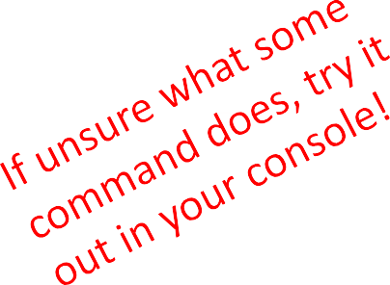
STRINGS
can slice strings using [start:stop:step]
if give two numbers, [start:stop], step=1 by default
you can also omit numbers and leave just colons
s = "abcdefgh"
s[3:6] → evaluates to "def", same as s[3:6:1] s[3:6:2] → evaluates to "df"
s[::]
s[::-1]
→ evaluates to "abcdefgh", same as s[0:len(s):1]
→ evaluates to "hgfedbca", same as s[-1:-(len(s)+1):-1]
s[4:1:-2]→ evaluates to "ec"

Slide 23

STRINGS
strings are “immutable” – cannot be modified
s = "hello"
s[0] = 'y'
s = 'y'+s[1:len(s)]
→ gives an error
→ is allowed,
s bound to new object
"hello"
"yello"
s

Slide 24
for LOOPS RECAP
for loops have a loop variable that iterates over a set of values
for var in range(4):
<expressions>
→ var iterates over values 0,1,2,3
→ expressions inside loop executed with each value for var
for var in range(4,6): → var iterates over values 4,5
<expressions>
range is a way to iterate over numbers, but a for loop variable can iterate over any set of values, not just numbers!

Slide 25
STRINGS AND LOOPS
these two code snippets do the same thing
bottom one is more “pythonic”
s = "abcdefgh"
for index in range(len(s)):
if s[index] == 'i' or s[index] == 'u': print("There is an i or u")
for char in s:
if char == 'i' or char == 'u': print("There is an i or u")

Slide 26
FUNCTIONS
write reusable pieces/chunks of code, called functions
functions are not run in a program until they are “called” or “invoked” in a program
function characteristics:
has a name
has parameters (0 or more)
has a docstring (optional but recommended)
has a body
returns something

Slide 27
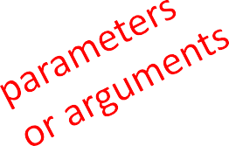
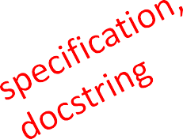
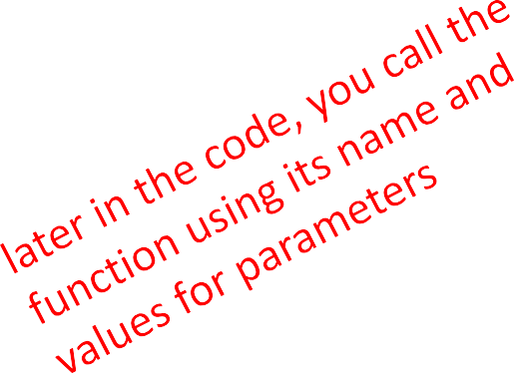
HOW TO WRITE and CALL/INVOKE A FUNCTION
def
is_even(
i
):
"""
Input: i, a positive int
Returns True if i is even, otherwise False """
print("inside is_even") return i%2 == 0
is_even(3)

Slide 28
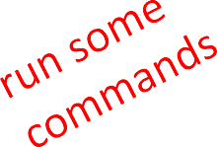
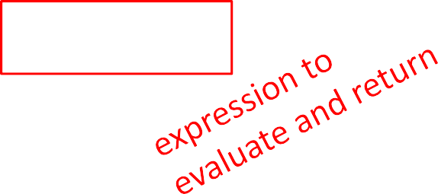

IN THE FUNCTION BODY
def is_even( i ): """
Input: i, a positive int
Returns True if i is even, otherwise False """
print("inside is_even")
return | i%2 == 0

Slide 29
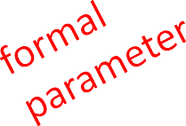
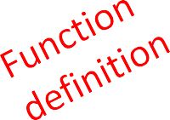
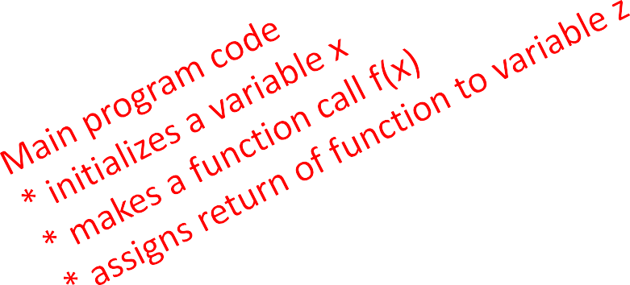
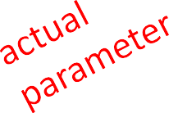
VARIABLE SCOPE
formal parameter gets bound to the value of
actual parameter when function is called
new scope/frame/environment created when enter a function
scope is mapping of names to objects
def f(
x
):
x = x + 1
print('in f(x): x =', x) return x
x = 3
z = f( x )

Slide 30
VARIABLE SCOPE
def f( x ):
x = x + 1
print('in f(x): x =', x) return x
Global scope
f scope
f
Some
code
x
3
x
3
x = 3
z = f( x )
z

Slide 31

VARIABLE SCOPE
def f( x ):
x = x + 1
print('in f(x): x =', x) return x
Global scope
f scope
f
Some
code
x
4
x
3
x = 3
z = f( x )
z

Slide 32
VARIABLE SCOPE
def f( x ):
x = x + 1
print('in f(x): x =', x) return x
Global scope
f scope
f
Some code
x
4
x
3
returns 4
x = 3
z = f( x )
z

Slide 33
VARIABLE SCOPE
def f( x ):
x = x + 1
print('in f(x): x =', x) return x
Global scope
f
Some
code
x
3
x = 3
z = f( x )
4
z

Slide 34
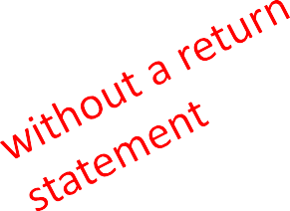
ONE WARNING IF NO
return STATEMENT
def is_even( i ):
"""
Input: i, a positive int Does not return anything """
i%2 == 0
Python returns the value None, if no return given
represents the absence of a value

Slide 35
return vs. print
return only has meaning
inside a function
only one return executed inside a function
code inside function but after return statement not executed
has a value associated with it, given to function caller
print can be used outside
functions
can execute many print statements inside a function
code inside function can be executed after a print statement
has a value associated with it, outputted to the console

Slide 36
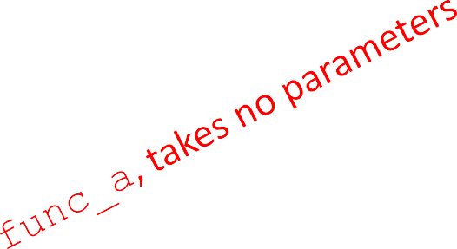
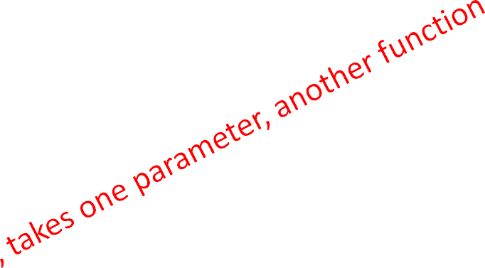
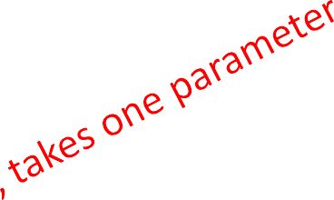
FUNCTIONS AS ARGUMENTS
arguments can take on any type, even functions
def func_a():
print 'inside func_a' def func_b(y):
print 'inside func_b' return y
def func_c(z):
print 'inside func_c' return z()
print
func_a()
print 5 +
func_b(2)
print
func_c(func_a)

Slide 37
FUNCTIONS AS ARGUMENTS
Global scope func_a scope
def | func_a():
 | print 'inside | func_a'
def | func_b(y):
 | print 'inside | func_b'
 | return y
def | func_c(z):
 | print 'inside | func_c'
 | return z()
func_a
Some code
Some code
func_b
Some code
func_c
None
returns None
print
print print
func_a()
5 + func_b(2) func_c(func_a)

Slide 38
FUNCTIONS AS ARGUMENTS
def func_a():
print 'inside func_a' def func_b(y):
print 'inside func_b' return y
def func_c(z):
print 'inside func_c' return z()
print func_a()
Global scope func_b scope
2
func_a
Some
code
y
Some code
func_b
Some code
func_c
None
7
returns 2
print 5 +
func_b(2)
print func_c(func_a)
23

Slide 39
FUNCTIONS AS ARGUMENTS
Global scope func_c scope
def func_a():
print 'inside func_a' def func_b(y):
print 'inside func_b' return y
def func_c(z):
print 'inside func_c'
func_a
Some
code
z
func_a
Some code
func_b
Some code
func_a scope
func_c
None
return
z()
print func_a() print 5 + func_b(2)
7
returns None
print func_c(func_a)
None
returns None

Slide 40
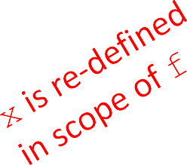

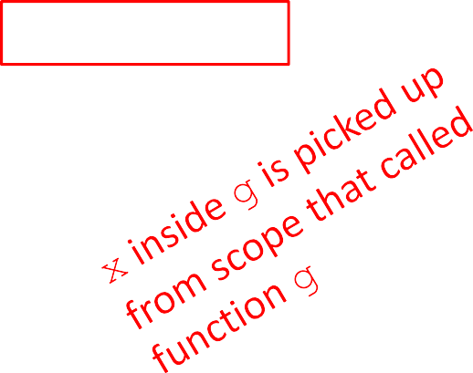
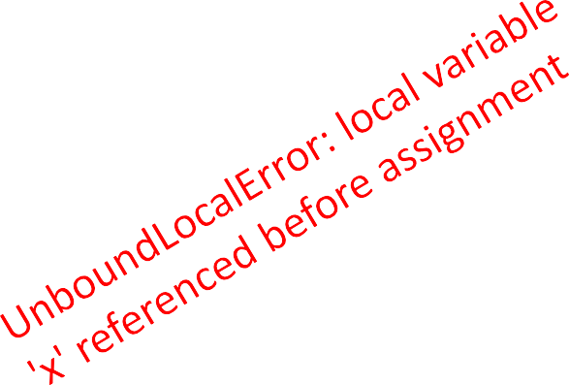
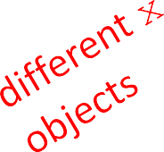
SCOPE EXAMPLE
inside a function, can access a variable defined outside
inside a function, cannot modify a variable defined outside -- can using global variables, but frowned upon
def f(y): def g(y): def h(y):
x = 1
print(x) print(x + 1)
x += 1
x += 1
print(x)
x = 5
x = 5 g(x) print(x)
h(x) print(x)
x = 5
f(x) print(x)

Slide 41
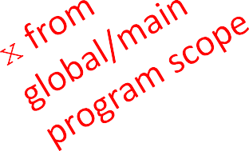
SCOPE EXAMPLE
inside a function, can access a variable defined outside
inside a function, cannot modify a variable defined outside -- can using global variables, but frowned upon
def f(y):
x = 1
x += 1
print(x)
def g(y):
print(x)
def h(y):
x += 1
x = 5 h(x)
x = 5 g(x)
x = 5 f(x)
print(x)
print(x)
print(x)

Slide 42
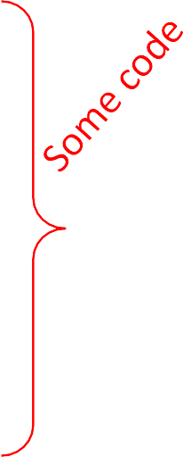
SCOPE DETAILS
def g(x):
Global scope
g
x
z
def | h():
 | x | = | 'abc'
x = | x | + | 1
Some code
print('g: x =', x) h()
3
 |  | return | x
x z | = = | 3 g(x)

Slide 43
SCOPE DETAILS
def g(x):
Global scope
g
x
z
g scope
x
h
def | h():
 | x | = | 'abc'
x = | x | + | 1
Some code
3
print('g: x =', x) h()
return x
3
Some code
x = 3
z = g(x)

Slide 44

SCOPE DETAILS
def g(x):
Global scope
g
x
z
g scope
x
h
def | h():
 | x | = | 'abc'
x = | x | + | 1
Some code
43
print('g: x =', x) h()
return x
3
Some code
x = 3
z = g(x)

Slide 45
SCOPE DETAILS
def g(x):
Global scope
g
x
z
g scope
h scope
def | h():
 | x | = | 'abc'
x = | x | + | 1
Some code
x
4
x
“abc”
3
print('g: x =', x) h()
return x
3
Some code
h
x = 3
z = g(x)
returns None

Slide 46

SCOPE DETAILS
def g(x):
Global scope
g scope
def | h():
 | x | = | 'abc'
x = | x | + | 1
g
Some code
x
4
print('g: x =', x) h()
return x
Some code
x
3
h
None
z
x = 3
z = g(x)
returns 4

Slide 47
SCOPE DETAILS
def g(x):
Global scope
g
x
z
def | h():
 | x | = | 'abc'
x = | x | + | 1
Some code
print('g: x =', x) h()
3
 |  | return | x
x z | = = | 3 g(x)
4

Slide 48
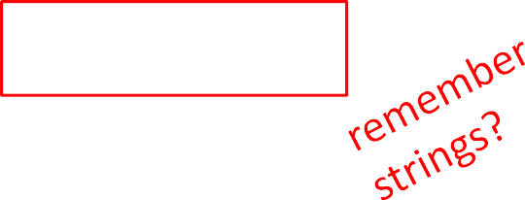

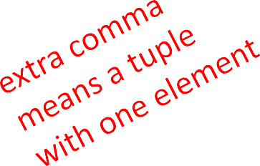
TUPLES
an ordered sequence of elements, can mix element types
cannot change element values, immutable
represented with parentheses
te = ()
t = (2,"mit",3) t[0]
(2,"mit",3) + (5,6)
→ evaluates to 2
→ evaluates to (2,"mit",3,5,6)
t[1:2]
t[1:3]
len(t)
→ slice tuple, evaluates to ("mit",)
→ slice tuple, evaluates to ("mit",3)
→ evaluates to 3
t[1] = 4 → gives error, can’t modify object

Slide 49

TUPLES
conveniently used to swap variable values
x = y
y = x
temp = x x = y
y = temp
(x, y) = (y, x)
used to return more than one value from a function
def quotient_and_remainder(x, y):
q = x // y
r = x % y return (q, r)
(quot, rem) = quotient_and_remainder(4,5)

Slide 50
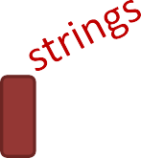
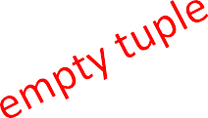

MANIPULATING TUPLES
aTuple:(( ),( ),( ))
can iterate over tuples
nums( )
def get_data(aTuple):
words( ? ? ? )
if not already in words
i.e. unique strings from aTuple
nums = ()
words = ()
for t in aTuple: nums = nums +
(t[0],)
if t[1] not in words:
words = words + (t[1],)
min_n = min(nums) max_n = max(nums)
unique_words = len(words)
return (min_n, max_n, unique_words)

Slide 51
LISTS
ordered sequence of information, accessible by index
a list is denoted by square brackets, []
a list contains elements
usually homogeneous (ie, all integers)
can contain mixed types (not common)
list elements can be changed so a list is mutable

Slide 52

INDICES AND ORDERING
a_list =
[]
L = [2, 'a', 4, [1,2]]
len(L) | → | evaluates to 4
L[0] | → | evaluates to 2
L[2]+1 | → | evaluates to 5
L[3]
L[4]
i = 2 L[i-1]
→ evaluates to [1,2], another list!
→ gives an error
→ evaluates to ‘a’ since L[1]='a' above

Slide 53

CHANGING ELEMENTS
lists are mutable!
assigning to an element at an index changes the value
L = [2, 1, 3]
L[1] = 5
L is now [2, 5, 3], note this is the same object L
[2,15,3]
L

Slide 54
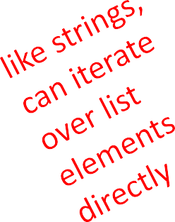
ITERATING OVER A LIST
compute the sum of elements of a list
common pattern, iterate over list elements
total = 0
for i in range(len(L)): total += L[i]
print total
notice
list elements are indexed 0
total = 0 for i in
L:
total += i print total
to len(L)-1
range(n) goes from 0 to n-1

Slide 55
OPERATIONS ON LISTS - ADD
add elements to end of list with L.append(element)
mutates the list!
L = [2,1,3]
L.append(5) → L is now [2,1,3,5]
what is the dot?
lists are Python objects, everything in Python is an object
objects have data
objects have methods and functions
access this information by object_name.do_something()
will learn more about these later

Slide 56
OPERATIONS ON LISTS - ADD
to combine lists together use concatenation, + operator, to give you a new list
mutate list with L.extend(some_list)
L1 | = | [2,1,3]
L2 | = | [4,5,6]
L3 | = | L1 + L2 | → | L3 is [2,1,3,4,5,6] L1, L2 unchanged
L1.extend([0,6])
→ mutated L1 to [2,1,3,0,6]

Slide 57
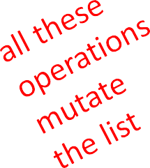
OPERATIONS ON LISTS - REMOVE
delete element at a specific index with del(L[index])
remove element at end of list with L.pop(), returns the removed element
remove a specific element with L.remove(element)
looks for the element and removes it
if element occurs multiple times, removes first occurrence
if element not in list, gives an error
L = [2,1,3,6,3,7,0] # do below in order L.remove(2) → mutates L = [1,3,6,3,7,0] L.remove(3) → mutates L = [1,6,3,7,0]
del(L[1])
L.pop()
→ mutates L = [1,3,7,0]
→ returns 0 and mutates L = [1,3,7]

Slide 58
CONVERT LISTS TO STRINGS AND BACK
convert string to list with list(s), returns a list with every character from s an element in L
can use s.split(), to split a string on a character parameter, splits on spaces if called without a parameter
use ''.join(L) to turn a list of characters into a string, can give a character in quotes to add char between every element
s = "I<3 cs" list(s) s.split('<')
L = ['a','b','c']
''.join(L)
'_'.join(L)
→ s is a string
→ returns ['I','<','3',' ','c','s']
→ returns ['I', '3 cs']
→ L is a list
→ returns "abc"
→ returns "a_b_c"

Slide 59
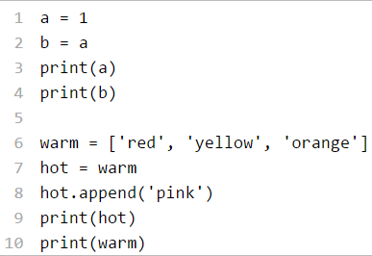
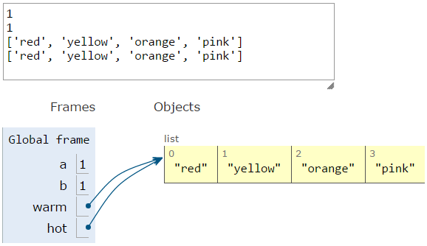
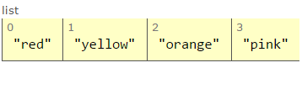
ALIASES
hot is an alias for warm – changing one changes the other!
append() has a side effect

Slide 60
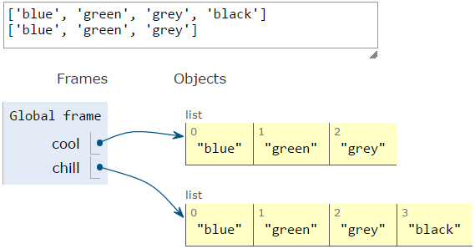
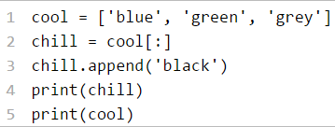
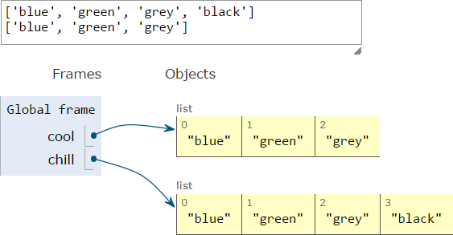
CLONING A LIST
create a new list and copy every element using
chill = cool[:]

Slide 61
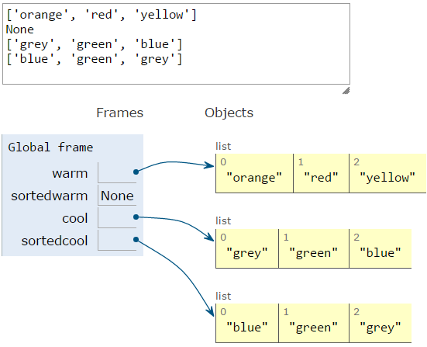
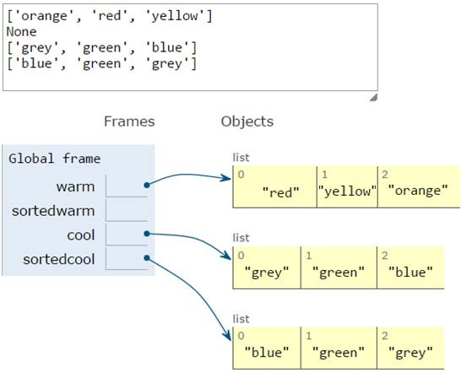
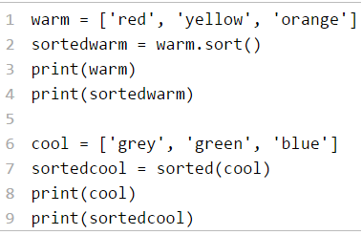
SORTING LISTS
calling sort() mutates the list, returns nothing
calling sorted() does not mutate list, must assign result to a variable

Slide 62
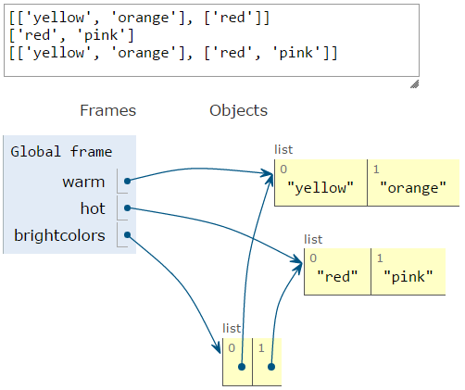
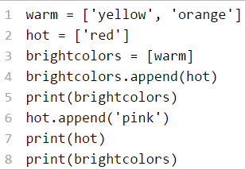
LISTS OF LISTS OF LISTS OF….
can have nested lists
side effects still possible after mutation

Slide 63
DICTIONARIES

Slide 64

HOW TO STORE STUDENT INFO
so far, can store using separate lists for every info
names = ['Ana', 'John', 'Denise', 'Katy']
grade = ['B', 'A+', 'A', 'A']
course = [2.00, 6.0001, 20.002, 9.01]
a separate list for each item
each list must have the same length
info stored across lists at same index, each index refers to info for a different person

Slide 65
HOW TO UPDATE/RETRIEVE STUDENT INFO
def get_grade(student, name_list, grade_list, course_list): i = name_list.index(student)
grade = grade_list[i]
course = course_list[i] return (course, grade)
messy if have a lot of different info to keep track of
must maintain many lists and pass them as arguments
must always index using integers
must remember to change multiple lists

Slide 66

A BETTER AND CLEANER WAY – A DICTIONARY
nice to index item of interest directly (not always int)
nice to use one data structure, no separate lists
A list A dictionary
0 | Elem 1
1 | Elem 2
2 | Elem 3
3 | Elem 4
… | …
Key 1 | Val 1
Key 2 | Val 2
Key 3 | Val 3
Key 4 | Val 4
… | …

Slide 67
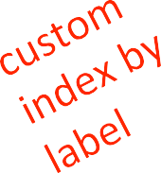


A PYTHON DICTIONARY
store pairs of data
key
value
'Ana' | 'B'
'Denise' | 'A'
'John' | 'A+'
'Katy' | 'A'
Key 1
Val 1
Key 2
Val 2
Key 3
Val 3
…
…
my_dict =
{}
grades = {'Ana':'B', 'John':'A+', 'Denise':'A', 'Katy':'A'}
key1 val1 key2 val2
key3 val3 key4 val4

Slide 68
DICTIONARY LOOKUP
similar to indexing into a list
looks up the key
returns the value associated with the key
if key isn’t found, get an error
grades = {'Ana':'B', 'John':'A+', 'Denise':'A', 'Katy':'A'}
'Ana' | 'B'
'Denise' | 'A'
'John' | 'A+'
'Katy' | 'A'
grades['John'] grades['Sylvan']
→ evaluates to 'A+'
→ gives a KeyError

Slide 69
DICTIONARY OPERATIONS | 'Ana' | 'B'
 | 'Denise' | 'A'
 | 'John' | 'A+'
 | 'Katy' | 'A'
 | 'Sylvan' | 'A'
grades = {'Ana':'B', 'John':'A+', 'Denise':'A', 'Katy':'A'}
add an entry
grades['Sylvan'] = 'A'
test if key in dictionary
'John' in grades 'Daniel' in grades
delete entry
del(grades['Ana'])
→ returns True
→ returns False

Slide 70
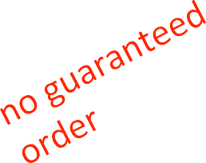

DICTIONARY OPERATIONS | 'Ana' | 'B'
 | 'Denise' | 'A'
 | 'John' | 'A+'
 | 'Katy' | 'A'
grades = {'Ana':'B', 'John':'A+', 'Denise':'A', 'Katy':'A'}
get an iterable that acts like a tuple of all keys
grades.keys() → returns ['Denise','Katy','John','Ana']
get an iterable that acts like a tuple of all values
grades.values() → returns ['A', 'A', 'A+', 'B']

Slide 71
DICTIONARY KEYS and VALUES
values
any type (immutable and mutable)
can be duplicates
dictionary values can be lists, even other dictionaries!
keys
must be unique
immutable type (int, float, string, tuple,bool)
actually need an object that is hashable, but think of as immutable as all immutable types are hashable
careful with float type as a key
no order to keys or values!
d = {4:{1:0}, (1,3):"twelve", 'const':[3.14,2.7,8.44]}

Slide 72
list vs
dict
ordered sequence of elements
look up elements by an integer index
indices have an order
index is an integer
matches “keys” to “values”
look up one item by another item
no order is guaranteed
key can be any
immutable type

Slide 73
OBJECTS
Python supports many different kinds of data
1234 3.14159 "Hello" [1, 5, 7, 11, 13]
{"CA": "California", "MA": "Massachusetts"}
each is an object, and every object has:
a type
an internal data representation (primitive or composite)
a set of procedures for interaction with the object
an object is an instance of a type
1234 is an instance of an int
"hello" is an instance of a string

Slide 74
OBJECT ORIENTED PROGRAMMING (OOP)
EVERYTHING IN PYTHON IS AN OBJECT (and has a type)
can create new objects of some type
can manipulate objects
can destroy objects
explicitly using del or just “forget” about them
python system will reclaim destroyed or inaccessible objects – called “garbage collection”

Slide 75
WHAT ARE OBJECTS?
objects are a data abstraction
that captures…
an internal representation
through data attributes
an interface for interacting with object
through methods
(aka procedures/functions)
defines behaviors but hides implementation

Slide 76
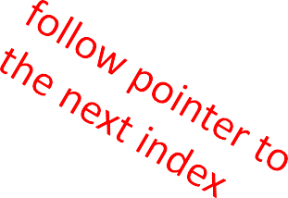
EXAMPLE:
[1,2,3,4] has type list
how are lists represented internally? linked list of cells
L =
1 -> 2 -> 3 -> 4 ->
how to manipulate lists?
L[i], L[i:j], +
len(), min(), max(), del(L[i])
L.append(),L.extend(),L.count(),L.index(),
L.insert(),L.pop(),L.remove(),L.reverse(), L.sort()
internal representation should be private
correct behavior may be compromised if you manipulate internal representation directly

Slide 77
ADVANTAGES OF OOP
bundle data into packages together with procedures that work on them through well-defined interfaces
divide-and-conquer development
implement and test behavior of each class separately
increased modularity reduces complexity
classes make it easy to reuse code
many Python modules define new classes
each class has a separate environment (no collision on function names)
inheritance allows subclasses to redefine or extend a selected subset of a superclass’ behavior

Slide 78
CREATING AND USING YOUR OWN TYPES WITH CLASSES
Implementing the class Using the class
make a distinction between creating a class and
using an instance of the class
creating the class involves
defining the class name
defining class attributes
for example, someone wrote code to implement a list class
using the class involves
creating new instances of objects
doing operations on the instances
for example, L=[1,2] and len(L)

Slide 79


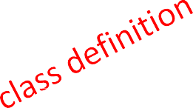
DEFINE YOUR OWN TYPES
Implementing the class
Using the class
use the class keyword to define a new type
class
Coordinate(object):
#define attributes here
similar to def, indent code to indicate which statements are part of the class definition
the word object means that Coordinate is a Python object and inherits all its attributes (inheritance next lecture)
Coordinate is a subclass of object
object is a superclass of Coordinate

Slide 80
WHAT ARE ATTRIBUTES?
data and procedures that “belong” to the class
data attributes
think of data as other objects that make up the class
for example, a coordinate is made up of two numbers
methods (procedural attributes)
think of methods as functions that only work with this class
how to interact with the object
for example you can define a distance between two coordinate objects but there is no meaning to a distance between two list objects

Slide 81
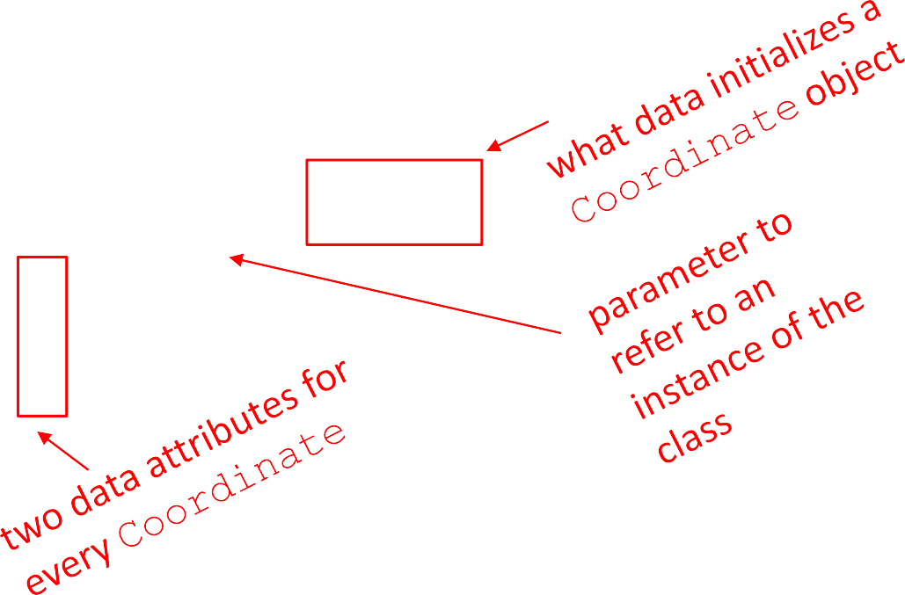
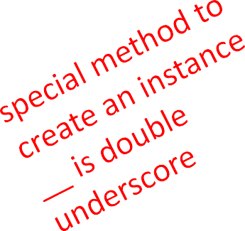


DEFINING HOW TO CREATE AN INSTANCE OF A CLASS
Implementing the class Using the class
first have to define how to create an instance of object
use a special method called
initialize some data attributes
class Coordinate(object):
init to
def init (self, x, y):
self.x | = | x
self.y | = | y

Slide 82
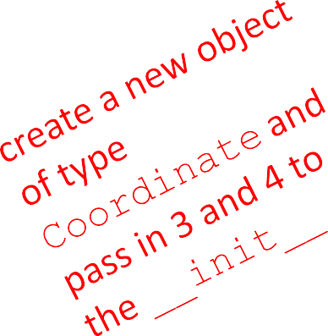
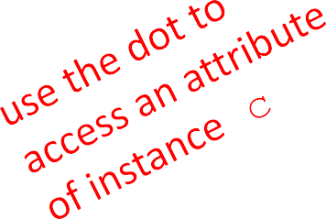
ACTUALLY CREATING AN INSTANCE OF A CLASS
Implementing the class Using the class
c =
Coordinate(3,4)
origin = Coordinate(0,0) print(c.x)
print(origin.x)
data attributes of an instance are called instance variables
don’t provide argument for self, Python does this automatically

Slide 83
WHAT IS A METHOD?
procedural attribute, like a function that works only with this class
Python always passes the object as the first argument
convention is to use self as the name of the first argument of all methods
the “.” operator is used to access any attribute
a data attribute of an object
a method of an object

Slide 84
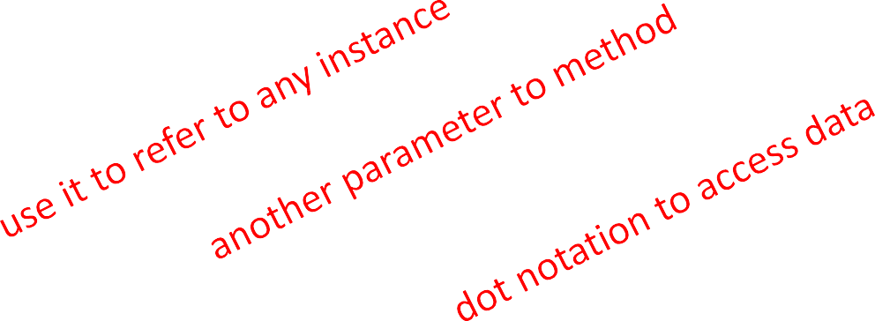
DEFINE A METHOD FOR THE
Coordinate CLASS
Implementing the class Using the class
class Coordinate(object): def init (self, x, y):
self.x = x self.y = y
def distance(self, other): x_diff_sq = (self.x-other.x)**2 y_diff_sq = (self.y-other.y)**2
return (x_diff_sq + y_diff_sq)**0.5
other than self and dot notation, methods behave just like functions (take params, do operations, return)

Slide 85

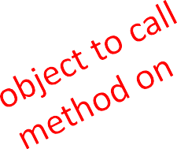
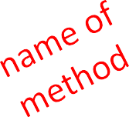

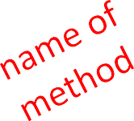

HOW TO USE A METHOD
Implementing the class
Using the class
def distance(self, other):
# code here
Using the class:
conventional way
c = Coordinate(3,4) zero = Coordinate(0,0)
equivalent to
c = Coordinate(3,4) zero = Coordinate(0,0)
print(c.distance(zero))
print(Coordinate.distance(c, zero))

